Slide 1
SWE 4701
Software Metrics and Process
Lec - 1

Slide 2
Classroom Rules
Be on time
Be a good Listener
Raise your hand to speak
Ask questions
Share new ideas
Contribute to discussions

Slide 3
Google Classroom & Online Class Info
Join using Class Code
3izs4gxj
Use only IUT email to join

Slide 4
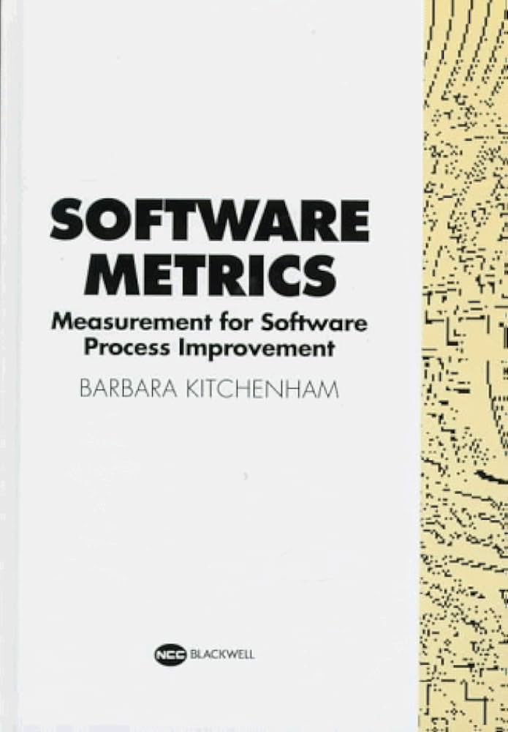
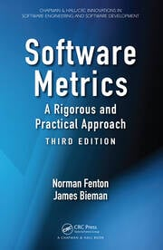
Important For you
Course Code: SWE 4701
Course Name: Software Metrics and Process
Recommended Books:
N. Fenton and J. Bieman, Software Metrics: A Rigorous and Practical Approach, 3rd ed. CRC Press, Inc., 2014
B. A. Kitchenham, Software Metrics: Measurement for Software Process Improvement. Blackwell Publishers, 1996
Following the lecture slides & class will be good enough

Slide 5
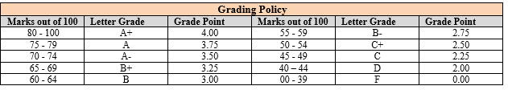
Assessment & Grading Policy
Course Assessment Method
Class participation | Quizzes and assignments | Mid-Term | Semester final
10% | 15% | 25% | 50%

Slide 6
Course Objective
Upon completion of this course, you will be able to:
01
Understand the fundamental principles of software measurement and the role of software metrics in software engineering.
02
Apply software metrics and statistical analysis techniques in software development, maintenance, and project management.
03
Develop prediction models and design a software measurement program to support process improvement.

Slide 7
Course Outcome(CO)
01
Explain key concepts, principles, and types of software metrics.
02
Apply software metrics and statistical analysis in evaluating software processes, products, and projects.
03
Develop prediction models and design measurement programs for software engineering applications.

Slide 8
Outcome Based Education (OBE)
Course outcomes (COs) identify what the learner will know and be able to do by the end of a course or program.
Program Outcomes(POs) are narrower statements that describe what students are expected to know and be able to do by the time of graduation.
PO-1 | Engineering knowledge: Apply the knowledge of mathematics, science, engineering fundamentals and an engineering specialization to the solution of complex engineering problems.
PO-2 | Problem analysis: Identify, formulate, research and analyze complex engineering problems and reach substantiated conclusions using the principles of mathematics, the natural sciences and the engineering sciences.
PO-3 | Design/development of solutions: Design solutions for complex engineering problems and design system components or processes that meet the specified needs with appropriate consideration for public health and safety and of cultural, societal and environmental concerns.
PO-4 | Investigation: Conduct investigations of complex problems, considering experimental design, data analysis and interpretation and information synthesis to provide valid conclusions.
PO-5 | Modern tool usage: Create, select and apply appropriate techniques, resources and modern engineering and IT tools, including prediction and modeling, to complex engineering activities with an understanding of their limitations.
PO-6 | The engineer and society: Apply reasoning informed by contextual knowledge to assess societal, health, safety, legal and cultural issues and the consequent responsibilities relevant to professional engineering practice.
PO-7 | Environment and sustainability:Understand the impact of professional engineering solutions in societal and environmental contexts and demonstrate the knowledge of and need for sustainable development.
PO-8 | Ethics: Apply ethical principles and commit to the professional ethics, responsibilities and the norms of the engineering practice.
PO-9 | Individual work and teamwork: Function effectively as an individual and as a member or leader of diverse teams and in multidisciplinary settings.
PO-10 | Communication: Communicate effectively about complex engineering activities with the engineering community and with society at large. Be able to comprehend and write effective reports, design documentation, make effective presentations and give and receive clear instructions.
PO-11 | Project management and finance: Demonstrate knowledge and understanding of engineering and management principles and apply these to one’s work as a team member or a leader to manage projects in multidisciplinary environments.
PO-12 | Life-long learning: Recognize the need for and have the preparation and ability to engage in independent, life-long learning in the broadest context of technological change.

Slide 9
Outcome Based Education (OBE)
Exam Result is Not the Most Important Consideration by Employer
Communication (verbal & written)
Honesty/Integrity
Teamwork skills
Interpersonal skills
Strong work ethics
Motivation & initiative
Flexibility/adaptability
Analytical skills
Computer skills
Creativity
Organizational skills
Detail oriented
Leadership skills
Self confidence
Friendly/outgoing personality
Well mannered / polite
Tactfulness
CGPA
Sense of humor
Entrepreneurial skills/risk taker

Slide 10
Lecture Plan
Weeks | Topics
1 | Overview of software metrics, The basics of measurement
2 | Goal-based framework for software measurement
3 | Empirical investigation
4 | Measuring internal product attributes: size , Measuring internal product attributes: structure
5 | Measuring cost and effort
6 | Measuring external product attributes: quality
7 | Measuring software: reliability, Software test metrics

Slide 11
Measurement
Measurement is the process by which numbers or symbols are assigned to attributes of entities in the real world in such a way as to describe them according to clearly defined rules.
Few Questions:
  Sweetness can be measured with sugar content, but what about the overall flavor of a dish? Can a chef’s rating reliably measure the tastiness of a meal?
  Reading speed is an attribute of a student. Does measuring words per minute fully capture reading ability?
  Temperature is an attribute of a place. Is recording “30°C” sufficient to describe the warmth of a room?
  Responsiveness is an attribute of software. Can the number of milliseconds it takes to open a program fully capture responsiveness?
How difficult is it to answer these…
What is easy to measure is not always what truly matters.

Slide 12
What is not measurable, make measurable
If something is important but you cannot currently measure it, try to define it clearly and find a way to quantify it so that it can be analyzed, tracked, or improved.
Some attributes or qualities seem abstract or subjective, e.g., intelligence, creativity, customer satisfaction, or software usability.
Define specific indicators or criteria that approximate the attribute.
    For example:
    Intelligence → IQ test scores
    Creativity → Number of original ideas submitted or judged by experts
    Software usability → Task completion time, number of errors, user ratings
The goal is not perfect measurement, but a way to track, compare, and improve reliably.
Measurement: A quantitatively expressed reduction of uncertainty
based on one or more observations.
Measurement is a way to assign numbers to something using observations, helping us understand it more precisely and reducing our uncertainty.

Slide 13
measurement help us deal with uncertainty
Observations that reduce uncertainty
  Uncertainty exists when we don’t know what will happen.
  By observing or collecting data, we gain information that reduces that uncertainty.
  Example: Checking the weather forecast reduces uncertainty about whether it will rain.
Quantitatively measure the risk of negative events
  Risk is about the chance of something bad happening.
  Observations allow us to assign numbers to that chance.
  Example: If historical data shows that 1 out of 10 machines fails per month, we can predict the machine failure rate..
Quantitatively measure the likelihood of positive outcomes
  Similarly, observations help estimate the chance of something good happening.
  Example: A student practicing a certain number of problems per day may have a 90% chance of passing an exam….based on past data.

Slide 14
Brain Teaser
Suppose you want to find out the average time it takes developers in your organization to fix bugs, since shorter bug-fix times are generally better.
Rule of Five
There is a 93.75% chance that the median of a population is between the smallest and largest values in any random sample of five from the population.
For example, 5 randomly selected bug-fix times (in hours): 2, 5, 8, 12, 20
Using the Rule of Five:
There is a 93.75% chance that the median bug-fix time for all bug reports lies between 2 and 20 hours.
Why this is useful:
You can estimate the median bug-fix time without examining every bug report.
A sample of only five bugs is small enough to measure manually, saving time.
If you want a more precise estimate of the median, you can increase the sample size, which reduces uncertainty further.

Slide 15
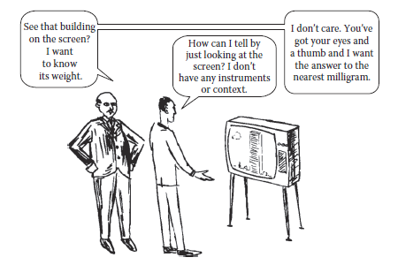
Measurement in Software Engineering
Measurement is essential to understand, control, and improve software processes.
Lack of measurement leads to cost overruns, poor quality, and unreliable systems.
Why Measurement is Needed
Helps set clear, measurable product and process goals.
Enables cost estimation and productivity analysis.
Allows assessment and prediction of software quality.
Supports scientific evaluation of tools, methods, and technologies.

Slide 16
Measurement Objectives
Managers:
  • Measure cost, productivity, quality, and customer satisfaction.
  • Use data for planning, control, and improvement.
Developers:
  • Ensure requirements are testable and measurable.
  • Track faults, verify goals, and predict future behavior.

Slide 17
Scope of Software Metrics
Software metrics encompass a wide range of activities involving measurement.
  Key Areas of Focus:
    Cost and effort estimation
    Data collection and quality models
    Reliability and security metrics
    Structural complexity
    Capability maturity (CMMI)
    Management and evaluation

Slide 18
Cost and Effort Estimation
Managers need to predict costs early in the software life cycle.
Common Models:
  Boehm’s COCOMO II
  Albrecht’s Function Point model
The Approaches:
  Effort is a function of variables (Size, Capability, Reuse).
  Size is defined by Lines of Code (LOC) or Function Points.

Slide 19
Data Collection
The Foundation of Measurement
Quality measurement relies on careful data collection.
Challenges:
Collecting across diverse projects.
Ensuring consistency, completeness, and data integrity.
Requires defining measures unambiguously.
Application:
Essential for experiments, surveys, and case studies.

Slide 20
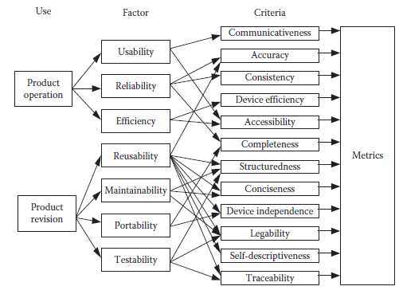
Quality Models and Measures
Measuring Quality (Divide and Conquer)
Quality involves many interacting factors.
Tree Structure Model:
  Factors: High-level attributes (e.g., Usability, Reliability).
  Criteria: Lower-level components (e.g., Modularity).
  Metrics: Actual measures proposed for the criteria.
Standard: Approaches like IEEE 1061-2009 use this hierarchy.

Slide 21
Reliability Models
Ensuring System Dependability
A specialized subset of quality modeling.
Goal is to predict and measure the likelihood of failure-free operation.
Methodology:
  Uses reliability theory.
  Analyzes and predicts software behavior over time.
  Critical for systems where failure is not an option.

Slide 22
Security Metrics
Assessing Risk and Vulnerability
Security is critical as computing permeates daily life.
Protects against data theft, corruption, and unauthorized access
Depends on:
  Internal system design.
  External attack vectors.
Key Metrics:
  Impact X Likelihood
  Threats and Vulnerabilities.

Slide 23
Structural and Complexity Metrics
It is about measuring Static Attributes
To predict reliability and maintainability before execution.
Method:
Measure representations available early (e.g., UML diagrams, Control Flow Graphs).
Focus Areas:
  Arrangement of program modules.
  Use of design patterns.
Benefit:
Identify difficult-to-test or high-maintenance areas early.
Supports:
Quality assurance, control & prediction

Slide 24
Capability Maturity Assessment
Evaluating Process Maturity
CMMI® (Capability Maturity Model Integration) – SEI
Assess an organization's ability to develop quality software.
Assessment → Hundreds of questions + certified assessor
Guides when & what to measure
5 maturity levels:
  Level 1 (Initial): Dependent on individuals.
  Level 5 (Optimizing): Quantitative process improvement.
Usage:
  often required for vendor contracts and government work.

Slide 25
Management by Metrics
Essential for project management & stakeholder communication
Uses charts, graphs, dashboards
Standard sets for project comparison
Especially important for non-software customers (e.g., power plant control software)
Translates technical progress for non-technical stakeholders (e.g., business clients).
Presents progress in understandable terms
Paints a clear picture of project health using charts and graphs.

Slide 26
Evaluation of Methods and Tools
Validating Productivity Claims
Many new methods/tools claim productivity & quality gains
Hard to separate hype from reality
Requires controlled experiments, case studies, surveys
Success depends on:
  Good experimental design
  Identifying influencing factors
  Proper measurement

Slide 27
Why Software Metrics Matter
Enables prediction, control, improvement throughout the software lifecycle
From early estimation → quality prediction → process optimization
Theoretical foundations unify all activities
Good measurement = Better decisions
Invest in careful data collection & meaningful metrics!

Slide 28
The Evolution of Physical Measurement
We often take measurement tools and principles for granted.
Sophisticated tools evolved alongside our understanding of attributes.
Example: The Mercury Thermometer.
  It wasn't obvious to early humans that the expansion of a liquid column (mercury) correlated to "hotter" or "colder."
  A theoretical framework describing temperature and materials had to be developed first.
The Software Measurement Gap
Unlike physical sciences, software engineering lacks:
  A deep understanding of software attributes.
  Sophisticated, universally accepted measurement tools.
Questions that are easy for physical objects (e.g., "How heavy is this?") are extremely difficult for software entities.

Slide 29
Critical Question
Question: How much must we know about an attribute before measuring it?
The Software Context:
  Can we truly measure "complexity"?
  Do we have a strict definition of what complexity actually is in a codebase?
You cannot effectively measure what you cannot clearly define.
Question: How do we verify that the metric matches the attribute?
The Software Context:
  Does counting "bugs" during testing actually measure "system quality"?
  A low bug count might just mean poor testing, not high quality.
We must validate that $Metric \text{≈} Attribute$

Slide 30
Critical Question
Question: What valid conclusions can be drawn from the data?
The Software Context:
  Is it mathematically meaningful to say we are "doubling" a design's quality?
  How do we compare Design A vs. Design B objectively?
Understanding the scale of measurement is necessary to make comparative statements.
Question: What math can we apply to these numbers?
The Software Context:
  Is it sensible to compute an "average"?
  Average productivity of a team vs. average quality of modules.
Not all mathematical operations (averaging, summing) are valid for all types of data.

Slide 31
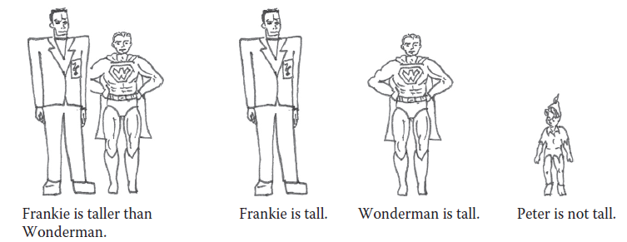
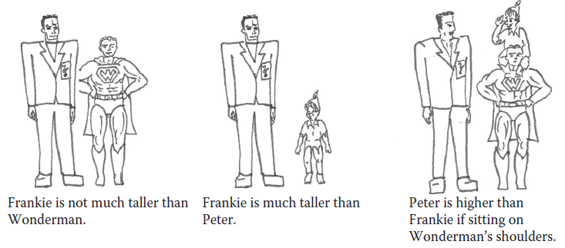
Theory of Measurement
Measurement is not random; it follows a set of rules.
Measurement Theory uses rules to understand attributes.
Rules ensure consistency and provide a basis for interpreting data.
We use rules to codify our intuition about the world into a formal system.
Representational theory of measurement (Empirical Relations )
Seeks to formalize our intuition about the way the world works.
We understand things by comparing them.
A valid empirical relation requires a general consensus (e.g., most people agree on who is taller).
taller than is an empirical relation for height
is a binary relation defined on the set of pairs of people.
Given any two people, x and y, we can observe that
  • x is taller than y, or
  • y is taller than x
Some empirical relations for the attribute height

Slide 32
Types of Empirical Relations
Relations can involve one, two, or multiple entities.
  Unary (One Entity): "Frankie is tall.“
  Binary (Two Entities): "Frankie is taller than Wonderman.“
  Ternary (Three Entities): "Peter is higher than Frankie if Peter sits on Wonderman’s shoulders.“
Our measurement system must capture these complex real-world interactions.

Slide 33
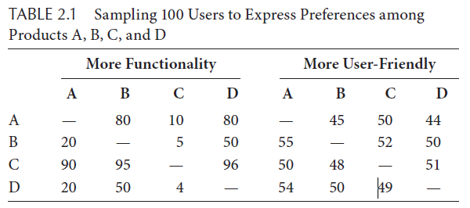
Developing Consensus
When Intuition Varies
Strong Consensus: Attributes like "Height" or "Functionality" often have clear winners (A is clearly better than B).
Weak Consensus: Attributes like "User-Friendliness" or "Taste" are subjective.
The Survey Approach:
  If 80% of users say A > B, we have a relation.
  If results are under certain %, the relation is "empty" (no consensus exists).
If we can't agree on the relationship, we aren't ready to measure it formally.
we say that product x has greater
functionality than product y if the survey result for cell (x,y) exceeds 60%.

Slide 34
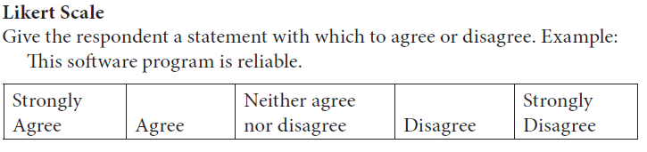
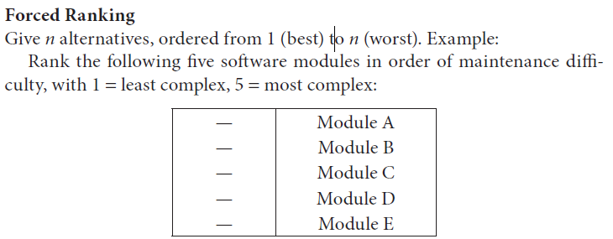
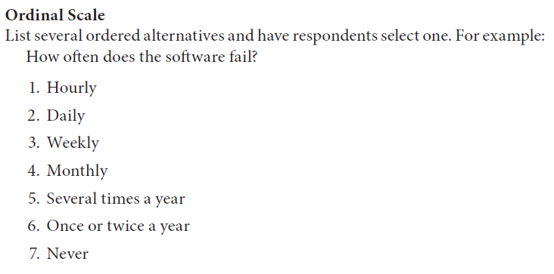
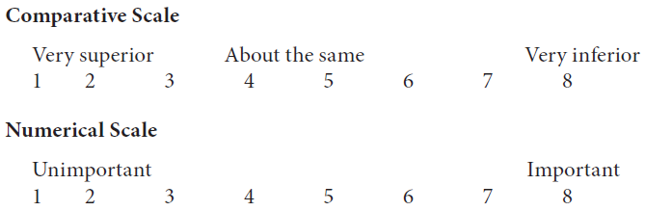
Capturing Subjective Data
When physical tools (like thermometers) don't exist, we use subjective ratings to establish empirical relations.
  Likert Scale: Strongly Agree to Strongly Disagree.
  Forced Ranking: Ordering items from 1 (Best) to N (Worst).
  Verbal Frequency: Always, Sometimes, Never.
These tools help structure vague observations into data.

Slide 35
Measurement Mapping
Mapping the Real World to Numbers
Measurement is a mapping from the Empirical World (Domain) to the Mathematical World (Range).
You must define how you map.
Example (Age):
  Western Rule: Count years since birth.
  Chinese Rule: Count from conception.
Different numbers for the same person based on different rules.
In software, definitions are often ambiguous.
Example: Lines of Code (LOC)
  Do we count comments?
  Do we count blank lines?
  Do we count executable code only?
Without explicit mapping rules, the numbers are meaningless.

Slide 36
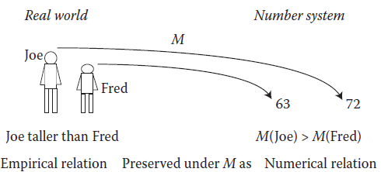
Measurement Mapping
We want the properties of the numbers to behave exactly like the entities in the real world.
Why? So that by studying the numbers, we learn the truth about the real world.
The mapping must preserve the relation. This is the Representation Condition.
A measurement mapping (M) must map entities to numbers and empirical relations to numerical relations. The empirical relations must preserve—and be preserved by—the numerical relations.
Empirical Relation: "A is taller than B“
Numerical Relation: M(A) > M(B)
Condition: A is taller than B if and only if M(A) > M(B).
Representation Condition

Slide 37
Preserving Relations
Binary Relation (Taller than):
Real World: A is taller than B
Math: M(A) > M(B)
Unary Relation (Is Tall):
Real World: A is considered "tall“
Math: M(A) > 70
Refined Binary (Much Taller):
Real World: A is much taller than B
Math: M(A) > M(B) + 15
Ternary Relation (Shoulder Height):
Real World: A is higher than B if sitting on C's shoulders.
Math: 0.7M(A) + 0.8M(C) > M(B)

Slide 38
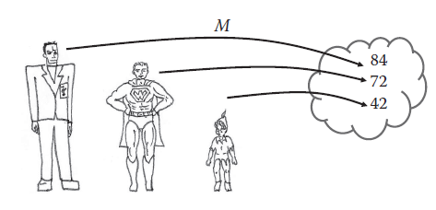



Validating a Measure (example)
Checking the Relations:
Taller than: A is taller than B -> 84 > 72 (True).
Is Tall: B is tall ->72 > 70 (True).
Much Taller: B is much taller than C -> 72 > (42 + 15) (True).
As the numbers preserve the relationships, this mapping is a valid measure.
The Mapping ($M$):
B = 72
A = 84
C = 42
Consider this alternate mapping:
The Invalid Mapping:
B = 72
A = 84
C = 60
The relation-
Much Taller: B is much taller than C -> 72 > (60 + 15) (False).
The relation is not preserved. This mapping is not a valid measure for "much taller than".

Slide 39
Key Stages of Formal Measurement
To create a valid metric, follow this process:
  Identify the Attribute: Pick the real-world entity property.
  Identify Empirical Relations: How do these entities relate in reality?
  Identify Numerical Relations: Pick math that corresponds to the reality.
  Define Mapping: Assign the numbers.
  Check Representation Condition: Verify that the math preserves the reality.

Slide 40
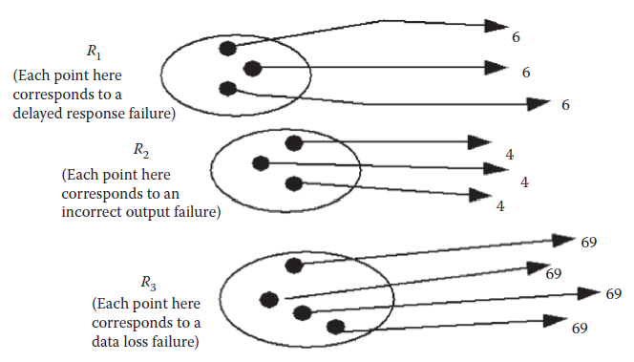
Software Example – Failure Types
Categorizing software failures.
  Relations: Three distinct types: Delayed-response (R1), Incorrect output (R2), Data-loss (R3).
  Constraint: We only know they are different.
This works because the only rule is "they are different."
Suppose we want to add to the above relation system a new (binary) relation, is more critical than. That is, each data-loss failure is more critical than each incorrect output failure and delayed response failure. each incorrect output failure is more critical than each delayed response failure.
Check: Is Incorrect > Delayed? 4 > 6 is False.
Result: The previous mapping is now invalid.
M(each delayed response) = 6
M(each incorrect output) = 4
M(each data loss) = 69
So, mapping need to be modified.

Slide 41
Context determines "Goodness"
A measure can be mathematically valid but contextually poor. Example: Faults per KLOC
Good Measure For: Rate of finding faults during testing (Process Tracking).
Poor Measure For: Tester efficiency (It ignores the difficulty of the code).
Questionable Measure For: Code Quality (High faults/KLOC might just mean rigorous testing, not necessarily bad design compared to another program).

Slide 42
Back to the model again
A model is an abstraction of reality.
It allows us to strip away unnecessary details to focus on a specific perspective.
Example: A cost model ignores the color of the user interface because that doesn't change the price.
The Role of Models in Measurement
Before We Measure, We Must Define
Measurement isn't just checking a number; it requires a defined model.
The Height Example:
  If we measure a person, we need rules.
  Do we include hair height?
  Are shoes allowed?
  What is the posture?
Software Example (LOC):
  Do comments count?
  Do data declarations count?
  What about separate statements on one line?

Slide 43
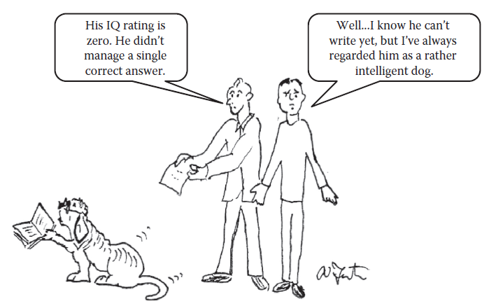
Defining Attributes (The Danger Zone)
Rushing to math without understanding the real world.
If you measure a dog's intelligence by its ability to write, it gets an IQ of 0.
The Mistake: The model was wrong for the entity.
We must define the characteristics of an attribute before we try to measure it.

Slide 44
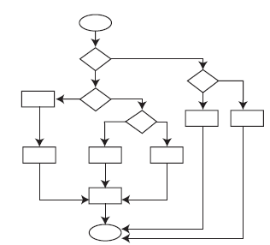
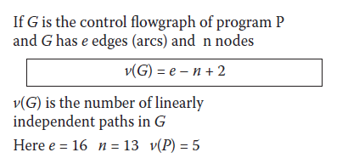
Modeling Complexity
How do we measure if code is "complex"?
The Model: A Directed Graph (Flowgraph).
The Measure (v): Counts linearly independent paths through the program.
High v(>10) = Hard to test and maintain.
It is a useful model, but partial. A program can have many paths but still be easy to read.

Slide 45
Direct vs. Derived Measurement
Direct Measurement:
Involves no other attribute.
Examples: Length of code (LOC), Duration of testing (Hours), Count of Defects.
Derived Measurement:
Combines multiple direct measures to create a new insight.
    Density = Mass / Volume.
Software Examples:
  Productivity = LOC / Person-Months.
  Defect Density = Defects / Module Size.

Slide 46
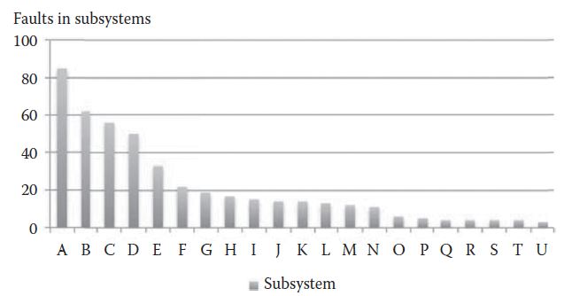
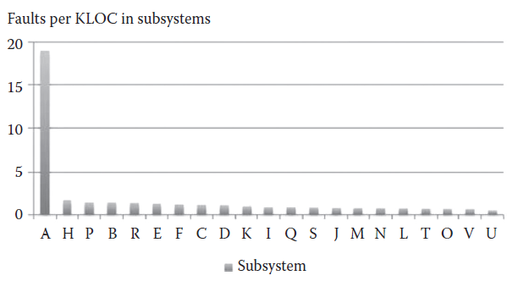
Why Derived Measurement Matters
Scenario: A large system with multiple subsystems (A through U).
Direct Measure (Count of Faults): five subsystems that contain the most problems.
Derived Measure (Faults per KLOC): Subsystem 'A' has the highest density of errors.
Insight: Subsystem 'A' is small but very broken.
Derived measurement tells us where to focus maintenance effort.

Slide 47
Measurement for Prediction
Assessment vs. Prediction
Assessment: Measuring what already exists (Past/Present).
Prediction: Estimating an attribute of an entity that does not yet exist.
The Need: We cannot wait for a project to finish to know if it will be over budget.
The Method: We need a model that relates current measures to future outcomes.
The Prediction System
It is more than just a formula. A prediction system has three parts:
The Model: The math (e.g., Cost = Distance * FuelPrice).
The Procedures: How we get the input data (e.g., do we ask a friend for the distance, or use a map?).
The Interpretation: Understanding the result (e.g., "This is an estimate with a 10% margin of error").
Changing the procedure (who you ask) changes the prediction, even if the model (the math) stays the same.

Slide 48
Measurement Scale
There are often many ways to measure the same thing
We classify these into five major types based on their "richness" (how much information they preserve).
The 5 Levels (from simplest to most restrictive):
  Nominal (Labels)
  Ordinal (Rank)
  Interval (Differences)
  Ratio (True Zero)
  Absolute (Counting)

Slide 49
Nominal Scale (The Classifier)
Characteristics:
  Categories only. No ordering.
  Used for classification or labeling.
  Numbers are just IDs (e.g., ID #1 is not "better" than ID #2).
Software Example:
  Fault Types: Specification Fault, Design Fault, Code Fault.
  We can label them 1, 2, and 3, but 3 isn't "more fault" than 1.
Admissible Transformation:
  One-to-one mapping. You can swap labels as long as you keep categories distinct. (A <—> B)

Slide 50
Ordinal Scale (The Ranker)
Characteristics:
  Preserves Order. We know A > B, but not by how much.
  Numbers represent rank, not magnitude.
  Math: You cannot add or subtract ranks (Rank 1 + Rank 2 ≠ Rank 3).
Software Example:
  Module Complexity: Trivial > Simple > Moderate >Complex.
  We know "Complex" is harder than "Simple," but is it twice as hard? We don't know.
Admissible Transformation:
  Monotonic Increasing. (M_{new} > M_{old} must always hold).

Slide 51
Interval Scale (The Difference Maker)
Characteristics:
  Preserves Order + Exact Differences.
  The "jump" from 1 to 2 is the same size as 10 to 11.
  No True Zero: Zero is arbitrary (it doesn't mean "nothing").
  Math: Addition/Subtraction is okay. Multiplication/Ratios are invalid (you can't say 40° is twice as hot as 20°).
Real World Example:
  Temperature: Celsius and Fahrenheit.
  Calendar Dates: Year 2014 vs. 2015.
Admissible Transformation (Affine):
  M' = aM + b (e.g., F = 1.8C + 32)

Slide 52
Ratio Scale (The Standard)
Characteristics:
  Preserves Order + Differences + Ratios.
  Has a True Zero: 0 means the total absence of the attribute.
  Math: All arithmetic is valid. You can say "Twice as long.“
Software Example:
  Program Length: Lines of Code (LOC).
  Development Time: Hours/Months.
  Note: A program with 0 lines has no length. A program with 200 lines is twice as long as one with 100 lines.
Admissible Transformation (Ratio):
  M' = aM (e.g., Convert Feet to Inches: F = 12I)

Slide 53
Absolute Scale (The Counter)
Characteristics:
  Most Restrictive.
  Only one way to measure: Counting.
  No conversion is possible (you can't measure a "count of people" in inches).
Software Example:
  Number of failures observed.
  Number of people on a team.
Admissible Transformation:
  Identity only. M' = M. (The count is the count).

Slide 54
The Common Pitfall (Ratio vs. Absolute)
Don't Confuse Counting with Ratio!
Ratio Scale: You measure an attribute (like Length) using a unit (like LOC).
  Why? Because you could measure length in bytes or characters instead.
Absolute Scale: You measure the Number of Items.
  Why? There is only one way to count items.
Rule of Thumb:
  "Length of Program" (measured in LOC) - > Ratio.
  "Number of Lines" (measured by counting lines) - > Absolute.

Slide 55
Summary
Scale Type | Key Feature | Operations Allowed | Transformation
Nominal | Categories | =, ≠ | One-to-one
Ordinal | Ranking | <, > | Monotonic
Interval | Differences | +, - | M' = aM + b
Ratio | True Zero | ×, ÷ | M' = aM
Absolute | Counting | All | M' = M
As you move down the table, the scale becomes richer and allows for more powerful statistical analysis.

Slide 56
What is Meaningfulness?
A statement is meaningful if its truth value remains unchanged even if we change the unit of measurement (admissible transformation).
Example:
“A is twice as tall as B."
Is this meaningful? Yes. If A is 6ft and B is 3ft, he is twice as tall. Convert to inches (72in vs 36in), and he is still twice as tall. The truth survives the conversion.
Example:
"Tokyo is twice as hot as London."
Scenario:
London = 20°C, Tokyo = 40°C. (True in Celsius!)
Convert to Fahrenheit:
  London: 20 X 1.8 + 32 = 68°F
  Tokyo: 40 X 1.8 + 32 = 104°F
The statement is meaningless because temperature (Interval scale) does not support ratios.

Slide 57
Software context
The Statement:
  "Failure X is twice as critical as Failure Y."
  Scale: Ordinal (Ranked).
The Test:
  Mapping A: Failure Y = 3 (Moderate), Failure X = 6 (Severe). (True!)
  Mapping B: Failure Y = 4 (Moderate), Failure X = 5 (Severe). (False!)
  Since ordinal scales only preserve rank, not magnitude, claiming "twice as much" is meaningless.
The scale type dictates the math you can use.
Nominal: Mode (Most frequent). No Mean, No Median.
Ordinal: Median (Middle value). No Mean.
Interval: Mean (Average), Standard Deviation.
Ratio: Geometric Mean, Coefficients of Variation.

Slide 58
Why "Average" Can Be Dangerous
Example: Bug Fix Time (Resolution Time)
Imagine a sprint with 10 bugs.
Actual fix times (hours)
1, 1, 1, 2, 2, 2, 3, 4, 5, 40
Average=61/10​=6.1 hours
Why is this Misleading???
Alternatives

Slide 59
Objective vs. Subjective Measurement
Objective: Independent of the measurer (e.g., Lines of Code).
Subjective: Depends on human judgment (e.g., "How readable is this requirement?").
Subjective measures are still useful!
Example: Team rating requirements from 1 (Clear) to 5 (Confusing).
  Even if not perfectly precise, a high number of "5s" warns you that the project is in trouble.
  Ideally, aim for objective, but don't discard subjective data if it paints a useful picture.

Slide 60
The Problem of Multi-Attribute Measurement
The Scenario:
  You want to measure "Transport Quality" based on Time and Cost.
    Train: Slow but Cheap.
    Plane: Fast but Expensive.
The Issue:
  Can you say the Plane is "Better" than the Train?
    No. They are incomparable without a specific weighting (e.g., "I care 80% about speed").
Software case: Is a "Fast but Memory-Heavy" compiler better than a "Slow but Light" compiler?
Acknowledge that "Quality" is often a vector (a set of numbers), not a single number.

Slide 61
Complexity is not One Number
Example: Cyclomatic Complexity
  Often treated as the measure of complexity.
Reality:
  Graph X: Two sequential decisions (v=3).
  Graph Z: A loop (v=2).
The Conflict: Many programmers find loops harder to understand than sequences, yet the metric says the sequence is "more complex."
A single number rarely captures the full reality of "Complexity."
Check Example 2.32 and 2.33

